Slide 1
HPC at UNIGE
Get familiar with the Baobab and Yggdrasil clusters
Yann Sagon

Slide 2
Plan
Introduction
HPC Resources
Procedures
Good practices
R on HPC
Parallel computing
Demo

Slide 3
Introduction

Slide 4
What is a HPC cluster?
A very big computer?
A very fast computer?
A way to compute quickly?
Many computers?
At UNIGE: Baobab and Yggdrasil

Slide 5
Cluster (CPU nodes)
CPU
Central Processing Units
In modern HPC: 1 CPU = 1 core
Baobab: ~5600 CPUs, 109 GPUs and 27 TB RAM
Yggdrasil: ~4772 CPUs, 52 GPUs,

Slide 6
Cluster (GPGPU nodes)
GPGPU
General-purpose Computing on Graphical Processing Units
Providers: mainly NVIDIA with CUDA
Two types of GPGPU available on our clusters:
Single precision: TitanXp, RTX2080, RTX3080
3840 cores / 12GB RAM > Purpose: TensorFlow, ML
Double Precision: P100, V100:
3584 cores / 16GB RAM > Purpose: Numerical modelisation (meteo, chemical, physical)

Slide 7

Evolution of CPUs over time

Slide 8
Baobab architecture
INFINIBAND
NASAC
Network
Acces
Server
ACademic
NODES
STORAGE
ETHERNET

Slide 9
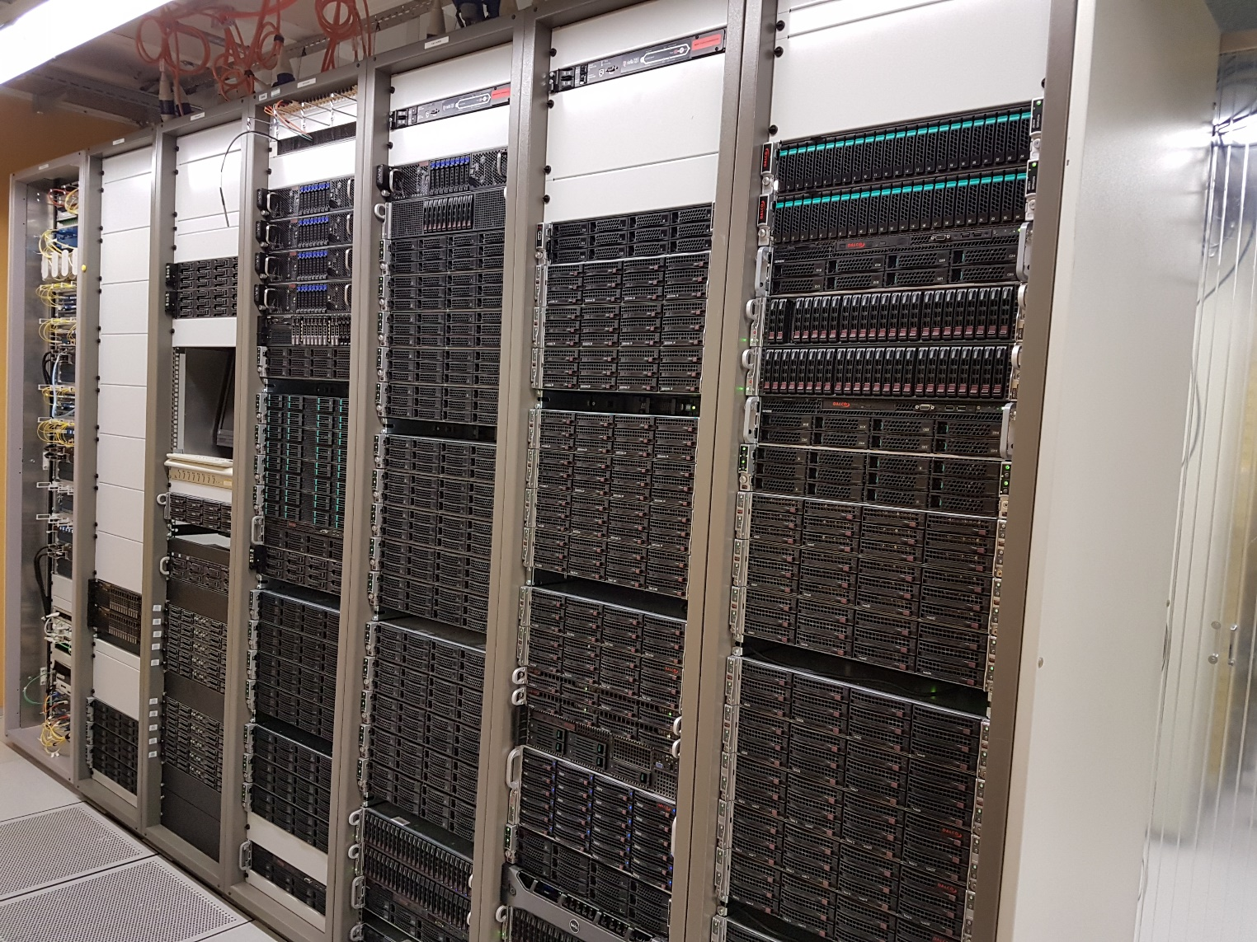
Baobab front

Slide 10
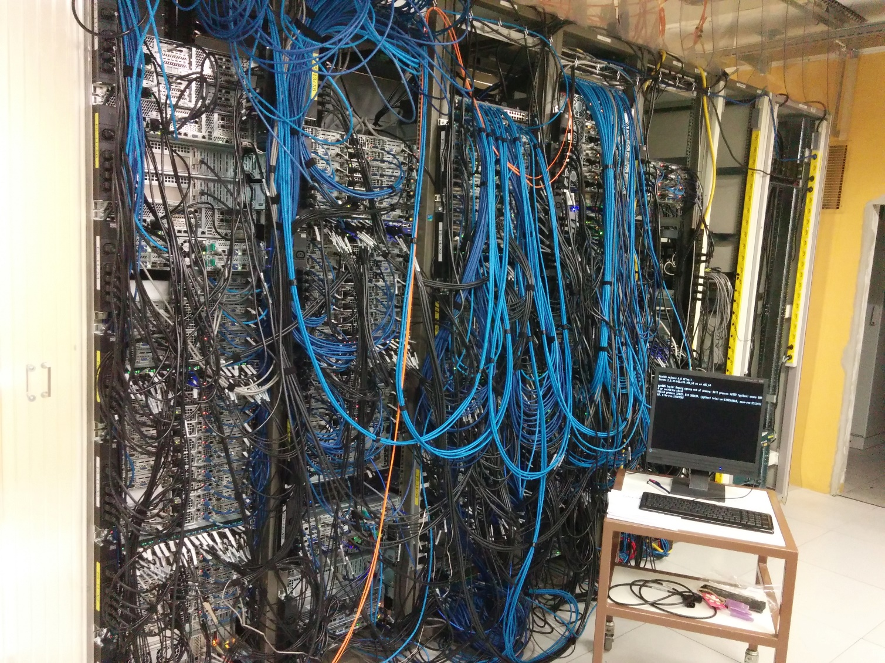
Baobab back

Slide 11
HPC resources

Slide 12
HPC Resources
Compute nodes (CPUs, GPGPUs …)
Memory (MB, GB)
Execution time (min, hours, days)
Software licenses (Matlab, stata…)
Storage space (home directory, scratch space, NAS)

Slide 13
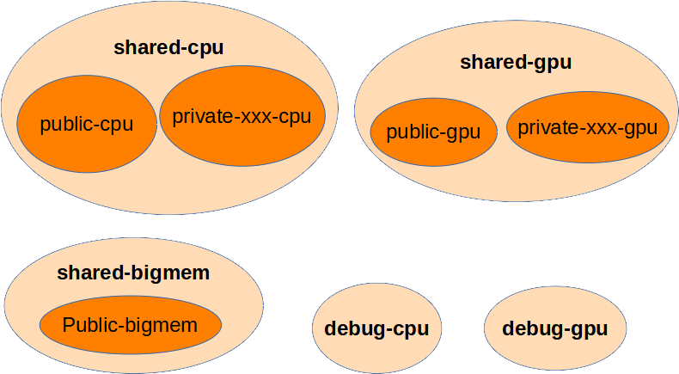
Partitions type : private and public
Partition = compute nodes grouping

Slide 14
Partitions
Choose the correct partition type
Debug? > debug-cpu
Runtime less than 12h00? > shared-cpu
Between 12h00 and 4 days? > public-cpu
More than 96GB RAM? > shared-bigmem
Need GPU? > shared-gpu
Interactive job max 8h, 1 job per user? > public-interactive-cpu

Slide 15
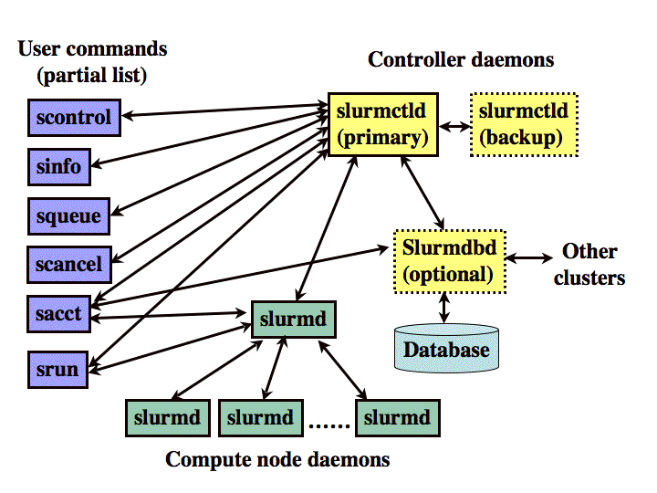
Resources management with SLURM
SLURM Simple Linux Utility for Resource Management

Slide 16
Resources management
Job priority in the waiting queue
Resources allocation and reservation
Job execution
Job archive
Slurm Documentation
https://slurm.schedmd.com

Slide 17
Job Priority
Four factors to prioritize jobs
Fair Share: The highest is the past usage, the lowest is the priority. SLURM forgets history ! (50% each 2 weeks)
Job Age: Priority increases with the waiting time in the queue
Job Size: Big jobs are favored
Partition Owner: Private partitions give higher priority to their owner

Slide 18
Procedures

Slide 19
HPC procedures
Registration and connection to Baobab or Yggdrasil
1 - Ask for an account on HPC (once)
2 - Connect to one of the cluster Baobab or Yggdrasil
Job preparation
3 - Transfer data and/or software to the cluster you use
4 - Write a script to submit your job to SLURM
Job execution
5 - Select the software to run (module)
6 - Check the correct execution of the job
7 - Run the job
Job completion
8 – See the job state
9 - Fetch the results

Slide 20
1 - Ask for an account
> Digital Workplace (Request form)

Slide 21
2 - Connection to Baobab
> Web interface for job monitoring (only for Baobab): https://baobab.unige.ch
Textual connection through SSH (putty, terminal)
Graphical session using x2go
> Access the hpc clusters

Slide 22

3 - Transfer data to Baobab
Transfer data using SFTP or SCP using for example FileZilla
>File transfer

Slide 23
4 - Write a script to submit your job sbatch script
Request needed resources
Number of CPUs > 1 to 128
Needed memory > 3 Go per core by default
License software (Optional)
Execution time > max 4 days
Choose partition > debug, public-cpu, shared-cpu etc
Select the software
Use module spider, module load
Specify input and output data
Specify log files (the program output)

Slide 24
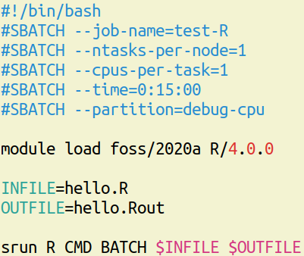
4 - sbatch script - Example
Use a text editor on the cluster (nano, gedit, vim etc).
If editing from Windows, be sure that you use notepad++, not notepad!
debug
SLURM directives
Module software
Job step

Slide 25
5 - Select the software to run (module)
5.1 - Search the needed software
5.2 - See the details of a specific version (if more than one available)
5.3 - Load the dependencies and the software
Applications and libraries

Slide 26
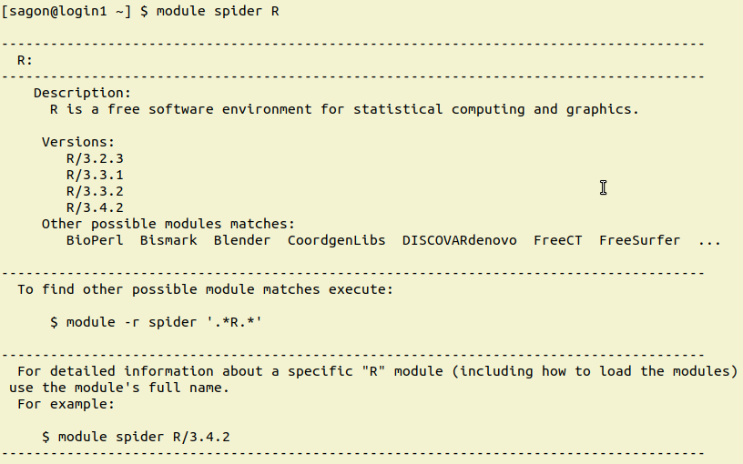
5.1 - Module spider
Search for R versions
Available R versions

Slide 27
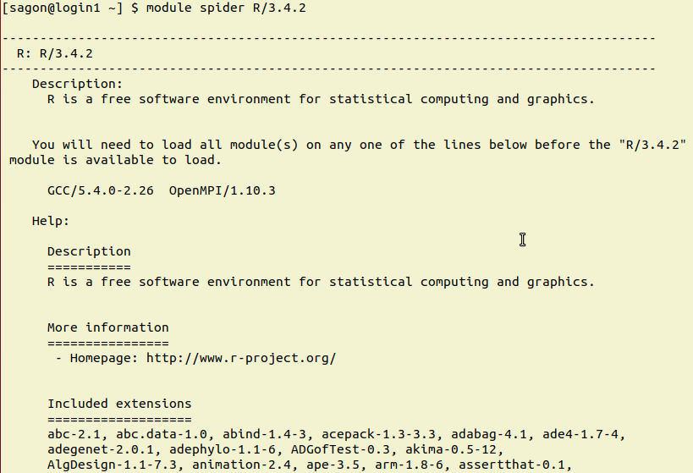
5.2 - Module details of a specific version
Show detail of R version 3.4.2
Dependencies (pick one line if many shown)

Slide 28
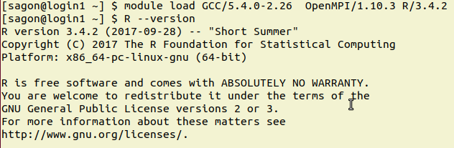
5.3 - Module load
Load R and it’s dependencies
R is loaded and available

Slide 29
6 - Check correct execution of the job
Submit your job into the debug-cpu partition
Check if everything is working fine
logs
result files
memory usage
CPU usage

Slide 30
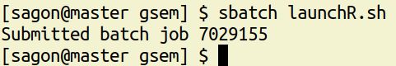
7 - Run the job
The job goes into the waiting queue
sbatch script
Job id

Slide 31
8 - See the job state
Job state > $ squeue –j job_id
See all your jobs: $ squeue –u your_username
Pending job
Running job
Reason why the job is pending

Slide 32
8 - See job state
See the job priority > $ sprio
See more details > $ scontrol show job job_id
See output files > (slurm-nnnnn.out and or slurm-nnnn.err) with tail, nano, vim
If you did a mistake, don’t let the job running !
Cancel the job > $ scancel job_id

Slide 33
9 - Fetch the result
Copy the results with FileZilla
Delete the unneeded temporary files

Slide 34
Good practices

Slide 35
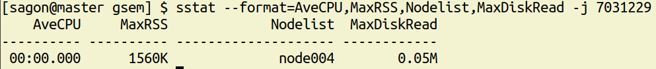
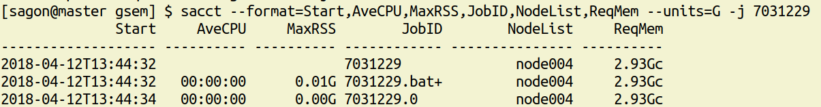
Analyze job behavior
When running > $ sstat
Memory used
Job step 0
When finished > $ sacct

Slide 36
Multithread, Distributed
Does your software benefit from multiple CPUs?
Hint: multicore, multithread in the documentation
Does your software benefit from multiple CPUs on more than one compute node?
Hint: openmpi in the documentation
How many cores?

Slide 37
R on HPC

Slide 38
R on Baobab and Yggdrasil
You can run Rstudio on the clusters
R instances on our clusters are fully loaded with hundreds of packages. No need to install them locally
You can install missing R packages in your home directory
HPC sbatch deployment scripts
R examples on our clusters

Slide 39
Multithread example using R
R only use one core by default
Use extra packages (mc, parallel etc)
Specify the number of cores to be used

Slide 40
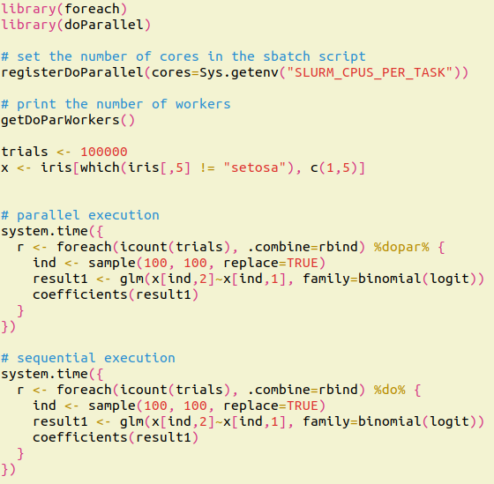
Multithread example using R
Load the parallel package
Get the number of CPUS from SLURM

Slide 41
Parallel computing

Slide 42
Parallel computing
The Amdahl’s law
Speedup
One woman takes 9 months to give birth Does 9 women give birth to one child in 1 month? Not everything is parallelizable!

Slide 43
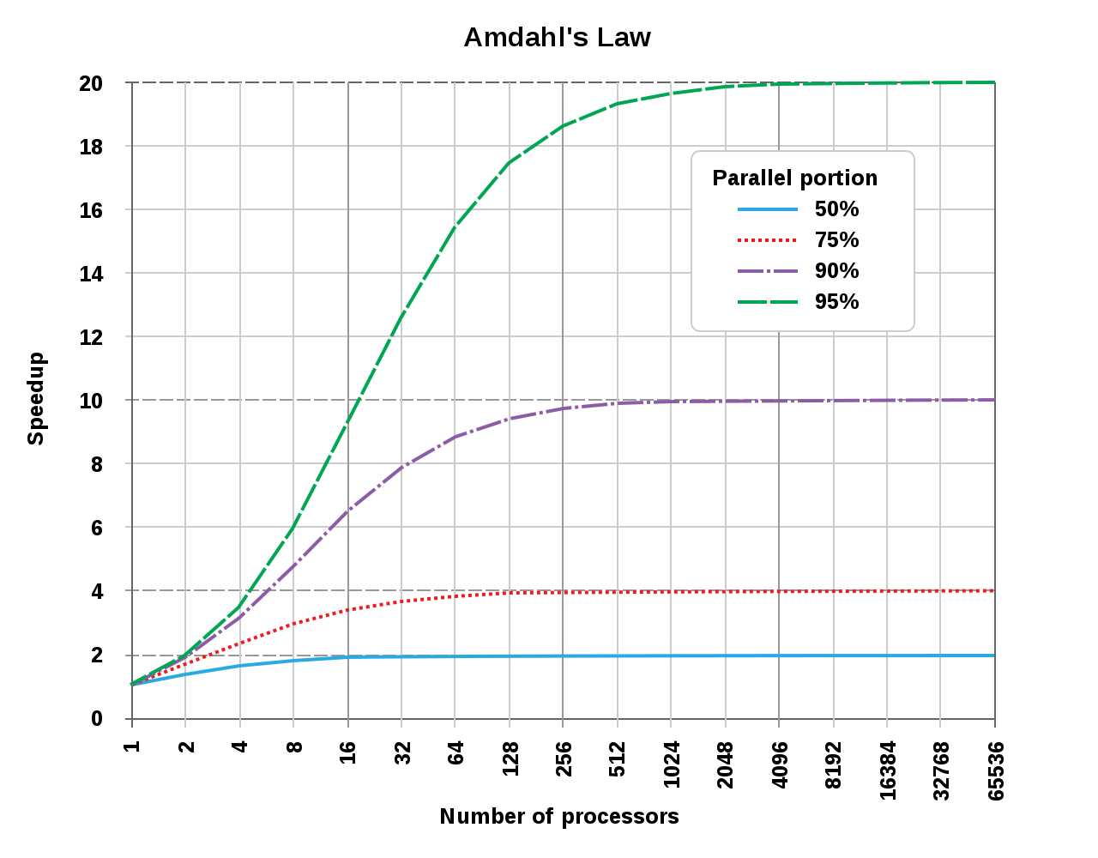
The Amdahl’s Law
https://fr.wikipedia.org/wiki/Loi_d%27Amdahl

Slide 44
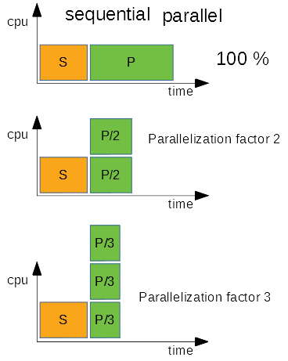
The Amdahl’s law illustrated
Speedup is limited by the «S» block
Measure run time with 1, 2, 4, 8, 16, 32, 64 cores
Stick with something reasonable (don’t double cpu for 5% gain!)

Slide 45
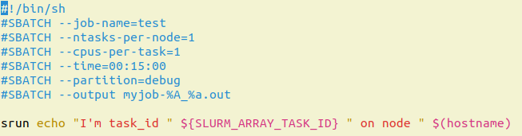
Embarrassingly parallel
Same job launched on different dataset: use a Job array!

Slide 46
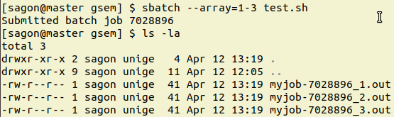
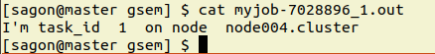
Embarrassingly parallel
Run 3 similar jobs

Slide 47
Useful links
Baobab welcome page > http://baobab.unige.ch
HPC documentation > direct links > https://doc.eresearch.unige.ch/hpc/
Best practices > https://doc.eresearch.unige.ch/hpc/best_practices
Connection > https://doc.eresearch.unige.ch/hpc/access_the_hpc_clusters#ssh_connection
Files transfer > https://doc.eresearch.unige.ch/hpc/access_the_hpc_clusters#file_transfer
Modules > https://doc.eresearch.unige.ch/hpc/applications_and_libraries
Slurm > https://doc.eresearch.unige.ch/hpc/slurm
sbatch > https://doc.eresearch.unige.ch/hpc/slurm#submitting_jobs

Slide 48
HPC Support
To get an access to Baobab > Digital Workplace(Request form)
FAQ : First of all, check the FAQ for general questions and troubleshooting.
Still couldn't find what you need ?
use the search engine (use @hpc to only search HPC related pages)
check the detailed Table of content.
The Glossary if everything sounds like gibberish.
Forum/Community (recommended) : The HPC community forum is the preferred way to ask a question if you didn't find a solution here. The forum is quite active and it is the best way to ask for help, share, or discuss with the community.
Before contacting us about an issue on the cluster, please check Current issues on Baobab and Yggdrasil
HPC-Lunch : First Thursday of each months, you can join our zoom session to discuss with us about HPC.
Email : For any other requests (confidential questions, meeting request, etc.) you can contact the HPC team by email (see here)
Your HPC support staff
> Yann Sagon, Luca Capello, Massimo Brero, Rémy Ressegaire (Astro)

Slide 49
Thanks for your attention !

